Slide 1
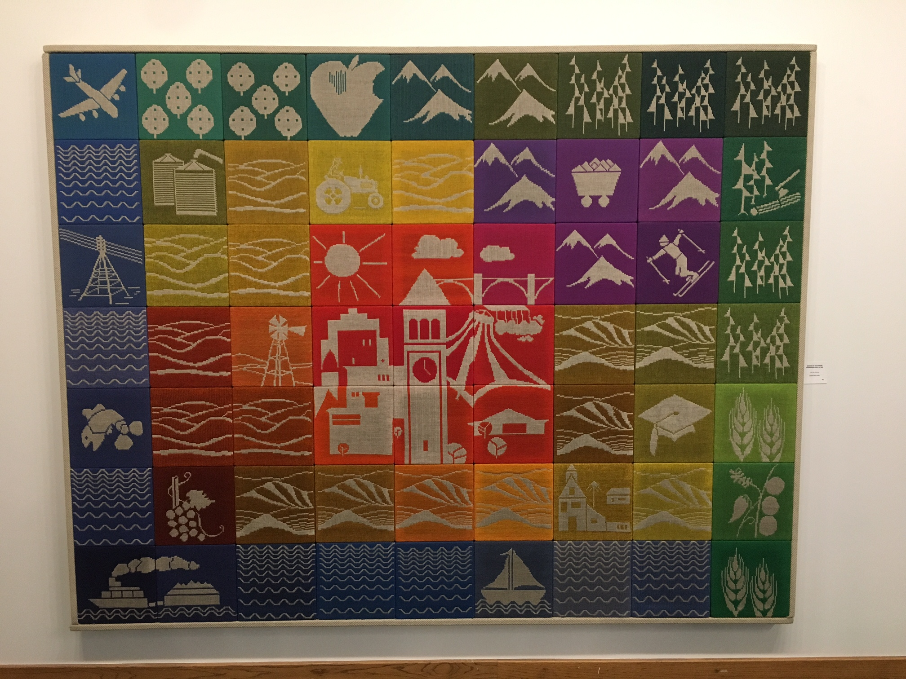

Slide 2
Sea Forms and Barnacles at City Hall

Slide 3
Seaforms: Barnacles and Fans on the move
The piece was commissioned by the City of Spokane at the time of the remodel of City Hall.
The new panels were created by Kop Construction and the panels were painted by Tom Quinn.
Display space made available by the Spokane Facilities District, tremendous help from Stephanie Curran, Chief Executive Officer and her staff.
The original designer/artist was Ken Weaver.

Slide 4
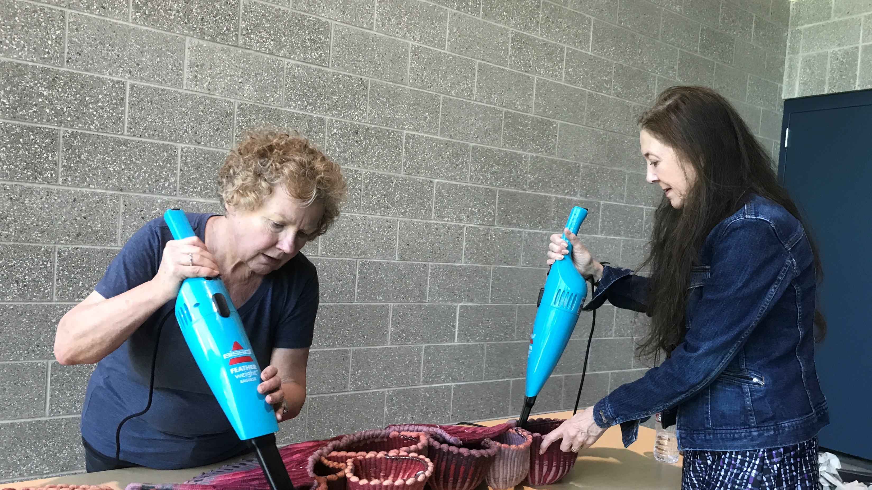

Slide 5
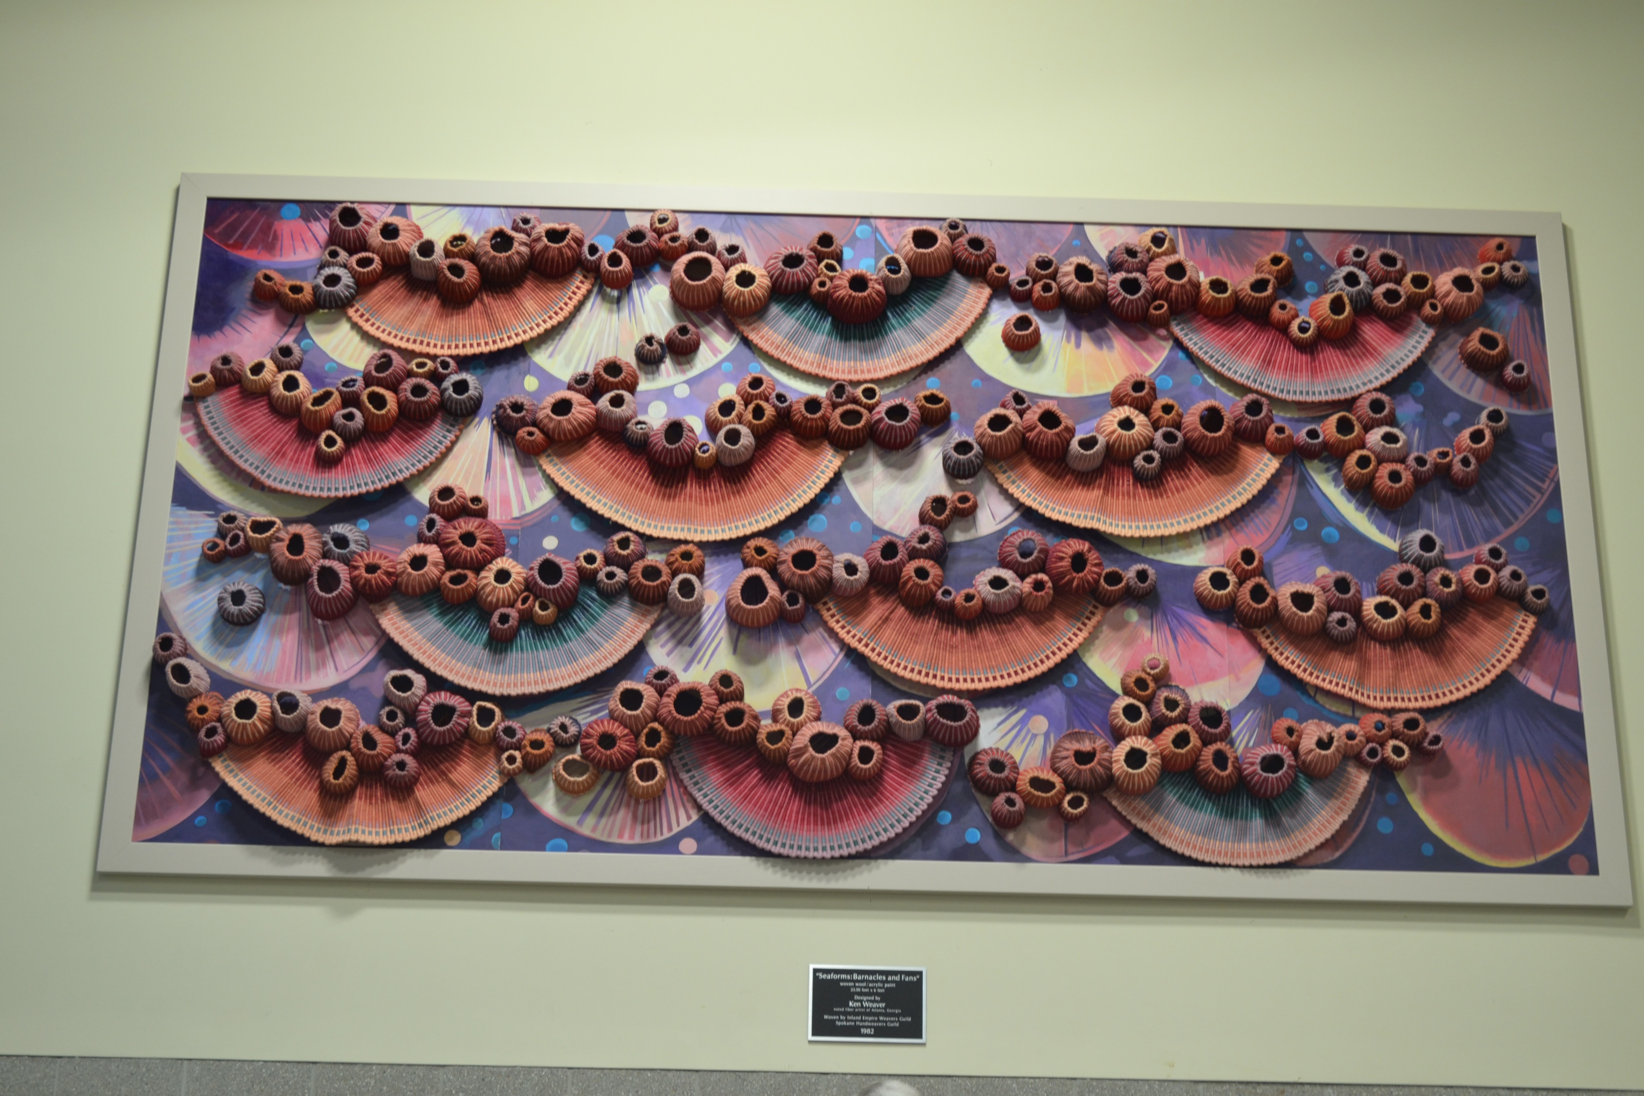

Slide 6
